Slide 1
Data Analysis Competition Montajat Wholesale Case
Ali Alsaihati 202034820
Hashem Almubarak 202012260

Slide 2
Table of contents
01
02
Introduction
Data Exploration
03
04
Data Analysis
Outcome

Slide 3
01
Introduction

Slide 4

01 Introduction
Simple questions but Important
What?
Why?
How?

Slide 5

02
Data Exploration

Slide 6
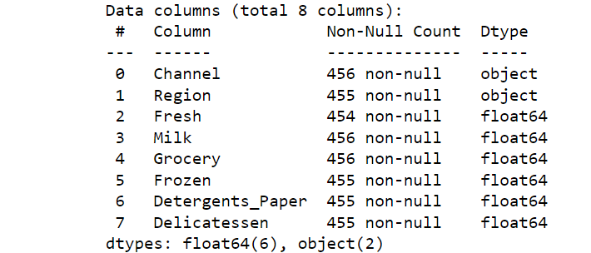

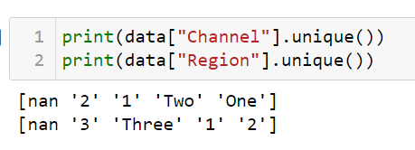
02 Data Exploration
Data description
Missing values
Inconsistency
Outliers

Slide 7

03
Data Analysis

Slide 8
03 Data Analysis
Category Insights
Customer Segment Analysis
Correlation Analysis
Channel-specific Insights
Regional Analysis

Slide 9
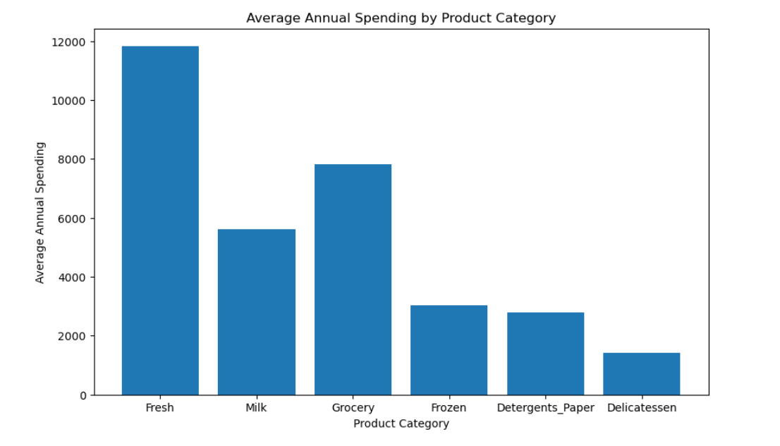
Category Insights

Slide 10
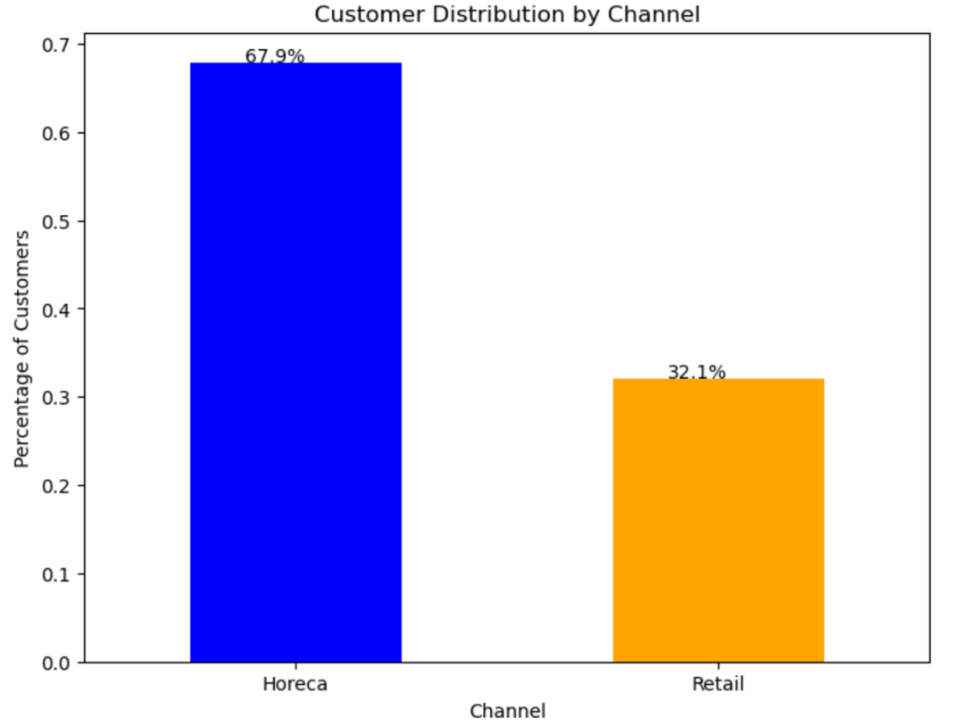
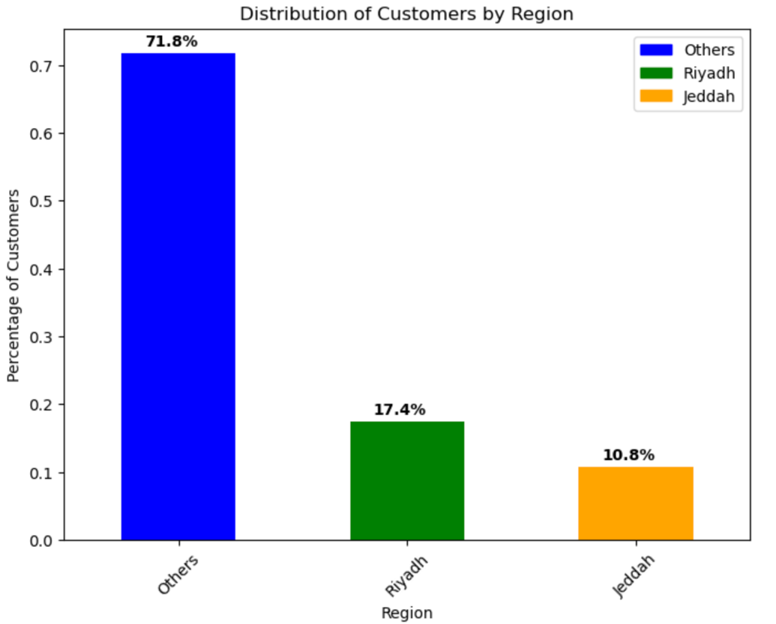
Customer Segment Analysis

Slide 11
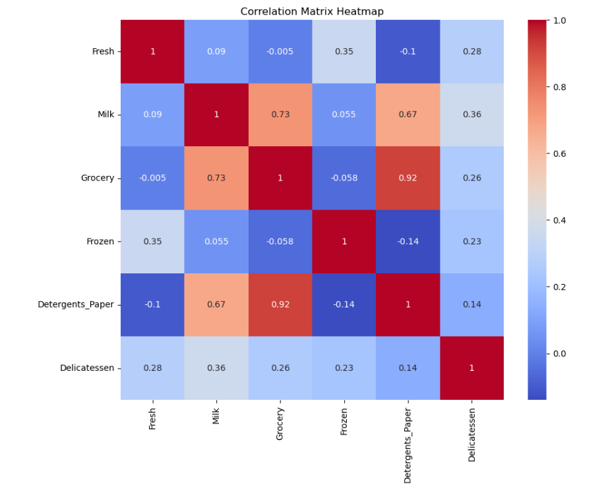
Correlation Analysis

Slide 12
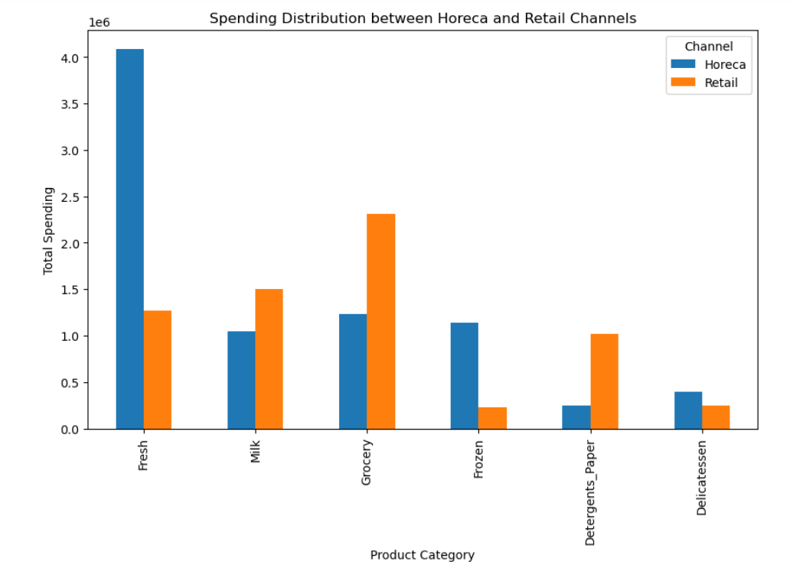
Channel-specific Insights

Slide 13
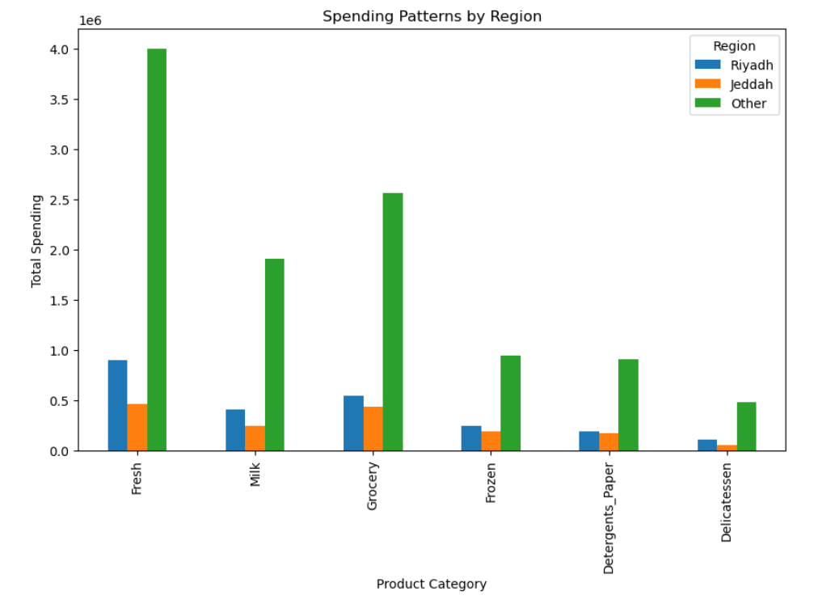
Regional Analysis

Slide 14

04
Outcome

Slide 15
04 Outcome
The "Other" region consistently demonstrates the highest overall spending across all product categories.
The fresh category dominates in all regions, indicating its high demand.
Montajat should prioritize providing fresh products to meet customer preferences.
Promoting other product categories can help attract customers and increase overall revenue.
By emphasizing fresh products and actively promoting their offerings, Montajat can capture customer attention and drive business growth.

Slide 16
Thank You
Are there any questions?

